Slide 1
Computer architecture and Organization Composite Architectures
M. Khademul Islam, PhD Professor, Dept. of CSE, Rajshahi University, Bangladesh Email: khademul.cse@ru.ac.bd, tel: +88-01727-786600 web: www.ru.ac.bd/cse/~mki

Slide 2
Composite Architecture
Multiprocessors:
The Computer system having two or more processing units
Share main memory and peripherals
Reasons of using multiprocessors:
Multiple users.
Multiple applications.
Multitasking within an application
Two types of multiprocessor systems:
Message Passing, Shared memory

Slide 3
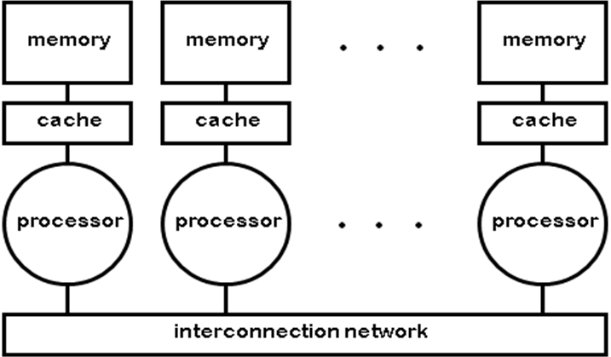
Composite Architecture
Message Passing
Separate address space for each processor
Processors communicate via message passing
Processors have private memories

Slide 4
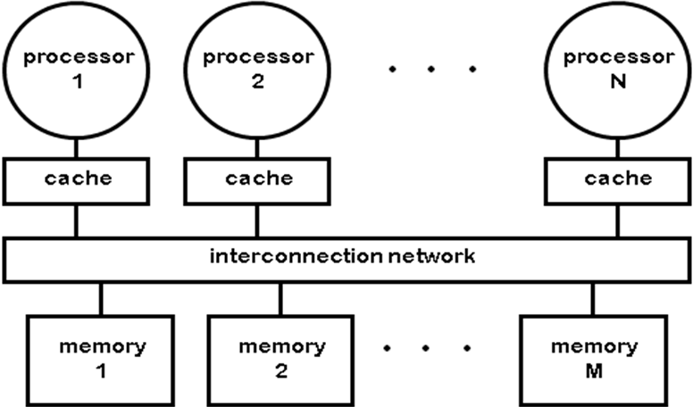
Composite Architecture
Shared Memory
Processors communicate with shared address space
Processors communicate by memory read/write
Easy on small-scale machines
Lower latency

Slide 5
Composite Architecture
Multicomputers
A computer made up of several computers.
Multicomputers are commonly used to get strong computing power.
A closely coupled processors that do not physically share memory
Cluster computers
Networks or clusters of computers
Can grow to a very large number of processors

Slide 6
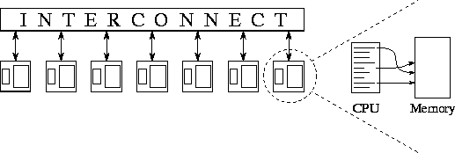
Composite Architecture
Multicomputer Consist of
Processing nodes – CPU, memory and network interface (NIC)
I/O nodes – device controller and NIC
Interconnection network

Slide 7
Composite Architecture
CISC –The PDP-11, 80x86 and Motorola 68K.
Complex instruction set computer (CISC)
Several CISC characteristics:
Complex instruction
Efficient use of memory
A small number of general purpose registers
Several special purpose registers
Properties of CISC instructions:
A 2-operand format, where instructions have a source and a destination.
Variable length instructions
Instructions which require multiple clock cycles to execute.

Slide 8
Composite Architecture
RISC –IBM 801, Stanford MIPS, and Berkeley RISC 1
Reduced Instruction Set Computer (RISC) is a type of microprocessor architecture that utilizes
A small, highly-optimized set of instructions
A more specialized set of instructions
One cycle execution time: RISC processors have a CPI (clock per instruction) of one cycle
Supports Pipelining
Large number of registers: the RISC design philosophy generally incorporates a larger number of registers to prevent in large amounts of interactions with memory

Slide 9
Composite Architecture
Comparison of CISC and RISC processors
CISC | RISC
Emphasis on hardware | Emphasis on software
Includes multi-clock complex instructions | Single-clock, reduced instruction only
Small code sizes, high cycles per second | Low cycles per second, large code sizes
Limited number of registers | Large number of registers

Slide 10
Composite Architecture
Parallel Processing
Parallel processing – executing more than one instruction at the same time.
It is possible to achieve parallelism with a uniprocessor system.
The CPU must include a vectored arithmetic unit.

Slide 11
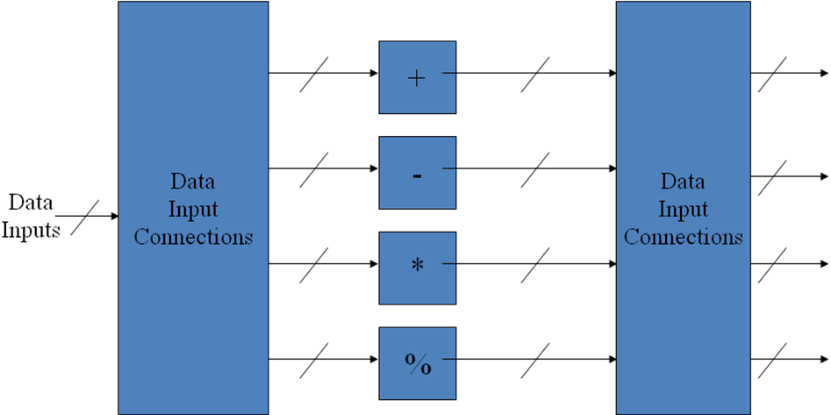
Composite Architecture
A vector arithmetic unit contains
Multiple functional
The control unit routes input values to the different functional units

Slide 12
Composite Architecture
Parallelism in multiprocessors
Parallel processing systems achieve parallelism by having more than one processor performing tasks simultaneously.
Since multiprocessor systems are more complicated than uniprocessor systems, there are many different ways to organize the processors and memory.

Slide 13
Composite Architecture
The Flyinn’s classification of parallel processing is as follows:
SISD: Single instruction with single data – conventional computers
SIMD: Single instruction with multiple data – vector computing machines
MISD: Multiple instruction with single data – pipelining system
MIMD: Multiple instruction with multiple data – general purpose machine

Slide 14
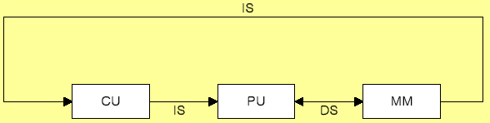
Composite Architecture
SISD
Practical purpose: one processor is useful

Slide 15
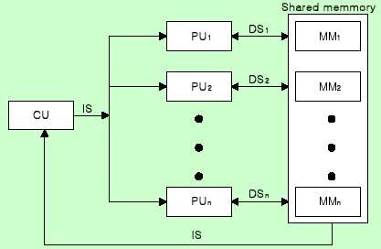
Composite Architecture
SIMD
Vector or array operations
one vector operation includes many operations on a data stream

Slide 16
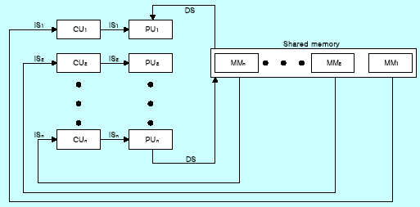
Composite Architecture
MISD
Data Stream bottle neck

Slide 17
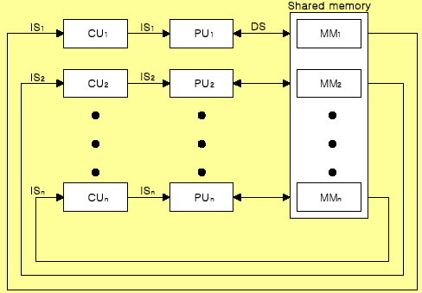
Composite Architecture
MIMD
Multiprocessor System
Shared memory or Message passing

